Slide 1
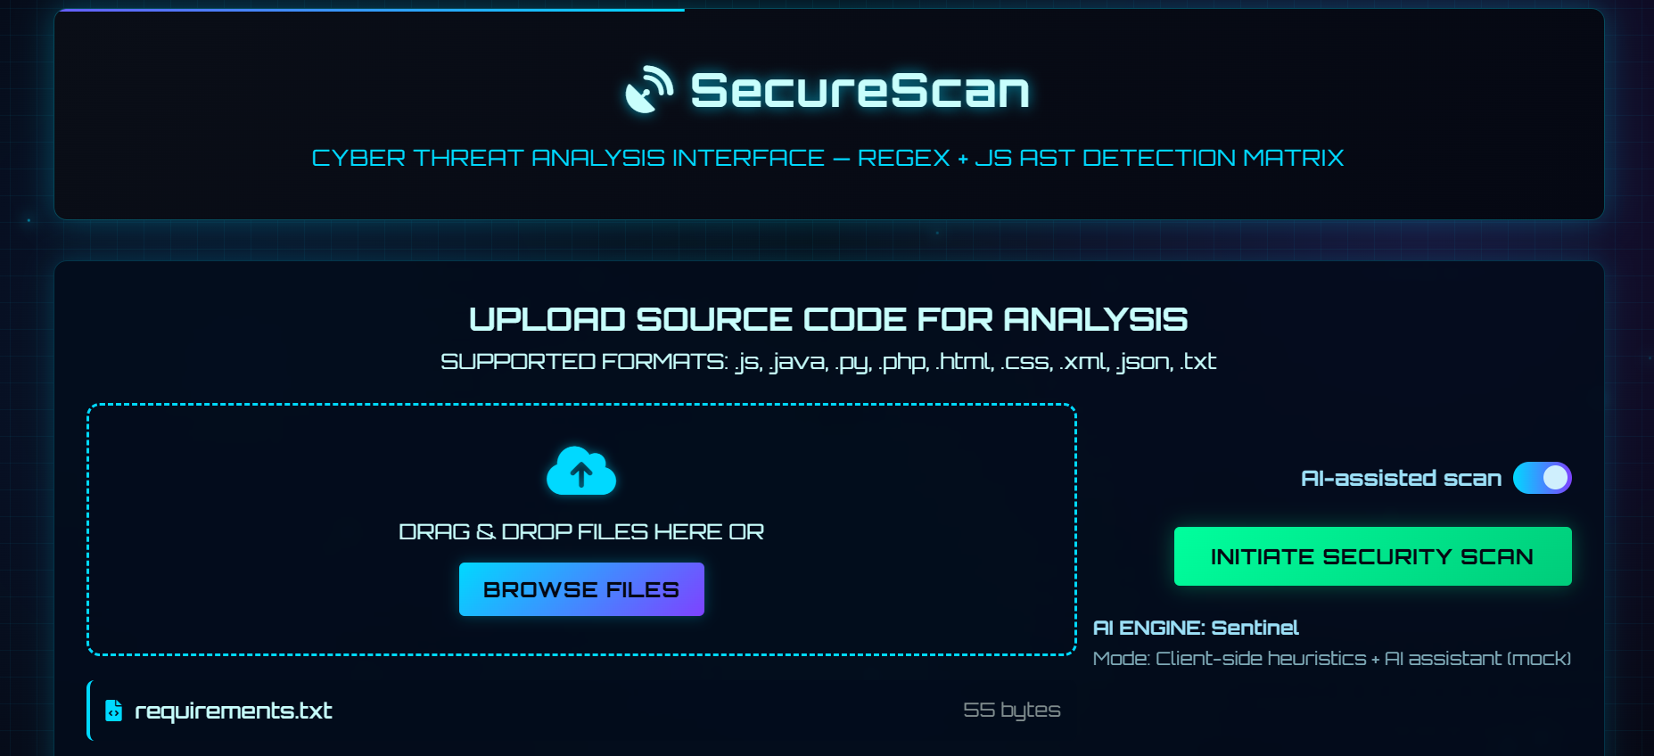
SOURCE CODE SCANNER
AI-Powered Vulnerability Scanning for Source Code
In today's fast-paced development environment, ensuring the security of source code is paramount. This presentation outlines the critical need for efficient vulnerability identification and introduces an innovative AI-powered solution designed to streamline this process, enabling developers to build more secure applications with greater confidence.

Slide 2
Integrated AI for efficient code scanning
Supported formats
Upload your files easily by browsing through your files

Slide 3
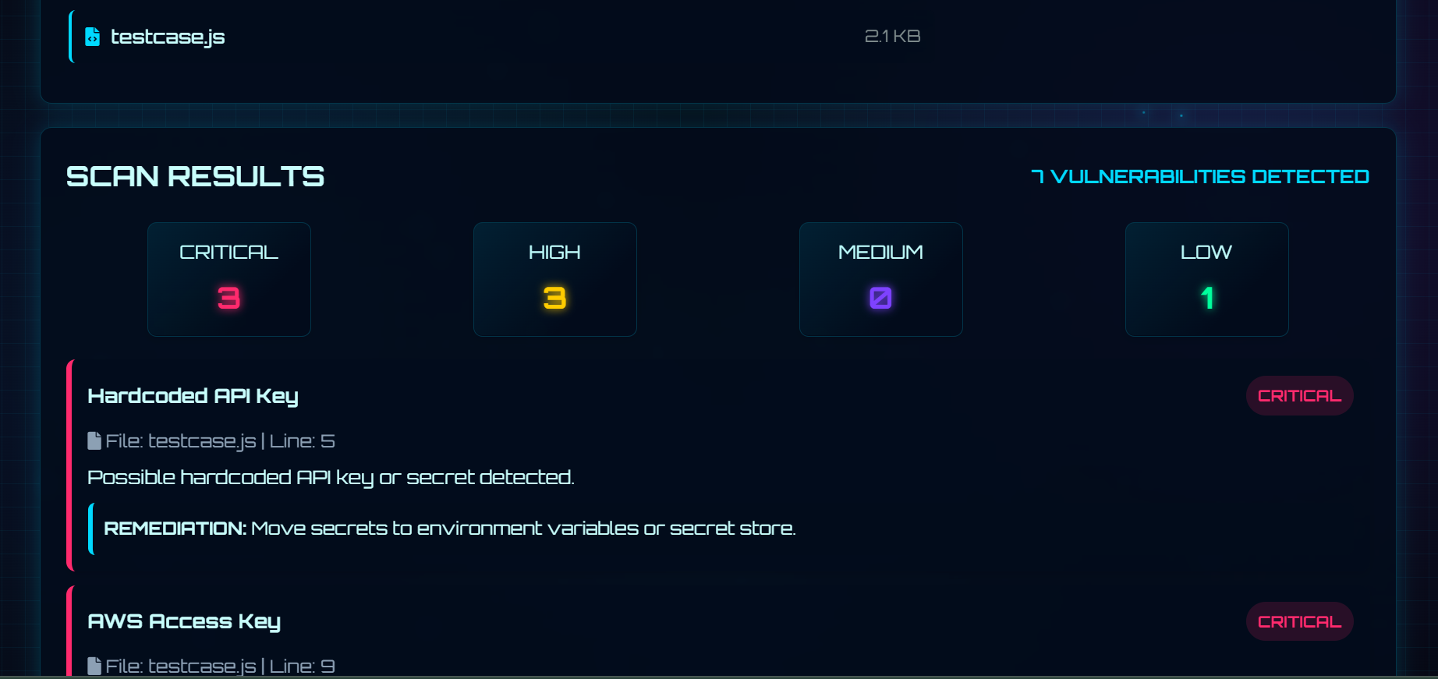
A structured report is provided listing vulnerabilities, location, type, and severity in the file scanned.

Slide 4
The Challenge: Manual Vulnerability Identification
Scalability Issues
As codebases grow and development cycles accelerate, manual methods simply cannot keep pace, creating a growing backlog of unreviewed code and increasing organizational risk.
Time-Consuming
Manually reviewing large codebases for security flaws is an incredibly laborious process, often requiring significant developer hours that could be spent on feature development or innovation.
Error-Prone
Human reviewers, despite their expertise, are susceptible to oversight, fatigue, and inconsistencies, leading to missed vulnerabilities and potential security breaches.

Slide 5
Introducing the AI-Powered Vulnerability Scanner
Our solution addresses the limitations of manual review by leveraging artificial intelligence to automate and enhance the vulnerability identification process.
1
Codebase Ingestion
The tool is designed to scan a directory of source code, supporting popular languages such as Python and JavaScript, ensuring broad applicability across diverse projects.
2
AI-Driven Analysis
Utilizing advanced AI algorithms, the scanner intelligently analyzes the code for patterns indicative of security weaknesses, going beyond simple signature matching.
3
Vulnerability Detection
It identifies potential vulnerabilities, including common and critical threats like SQL injection, Cross-Site Scripting (XSS), and hardcoded secrets.
4
Risk Prioritization
Crucially, the tool prioritizes identified vulnerabilities based on their perceived risk, allowing developers to focus on the most critical issues first for efficient remediation.

Slide 6
Key Vulnerabilities Targeted
Our AI scanner is specifically engineered to detect a range of high-impact security flaws that often plague modern applications.
SQL Injection
Detects vulnerabilities where malicious SQL code can be inserted into input fields, potentially compromising database integrity and confidentiality.
Cross-Site Scripting (XSS)
Identifies instances where attackers can inject client-side scripts into web pages viewed by other users, leading to session hijacking or data theft.
Hardcoded Secrets
Locates sensitive information like API keys, passwords, or cryptographic keys directly embedded in source code, which can be easily exposed.
Other Common Flaws
Beyond these, the AI is trained to recognize other prevalent security misconfigurations and insecure coding practices that could lead to exploitation.

Slide 7
How AI Enhances Detection
Unlike traditional static analysis tools that rely on predefined rules, our AI-powered solution offers a more dynamic and intelligent approach to vulnerability detection.
Pattern Recognition: AI models can learn complex patterns from vast datasets of secure and vulnerable code, enabling them to identify subtle anomalies that rule-based systems might miss.
Contextual Understanding: The AI understands the context of code execution, reducing false positives and providing more accurate vulnerability reports.
Adaptability: As new vulnerability types emerge, the AI can be retrained and updated, ensuring the tool remains effective against evolving threats without constant manual rule updates.
Language Agnostic Potential: While initially focused on Python and JavaScript, the underlying AI architecture can be extended to support additional programming languages with further training.

Slide 8
Prioritizing Risk for Efficient Remediation
A key feature of our tool is its ability to not just find vulnerabilities, but to intelligently prioritize them, transforming a daunting list into an actionable plan.
Low Risk
Minor issues with limited impact, often related to best practices rather than direct exploitation.
Medium Risk
Vulnerabilities that could be exploited under specific conditions, potentially leading to moderate impact.
High Risk
Critical flaws that are easily exploitable and could result in significant data breaches, system compromise, or service disruption.
Critical Risk
Immediate threats requiring urgent attention, often leading to full system control or widespread data loss if unaddressed.
This tiered approach ensures that development teams can allocate their resources effectively, tackling the most pressing security concerns first.

Slide 9
Benefits for Developers and Organizations
For Developers
Faster Feedback: Get immediate insights into security flaws during the development cycle, reducing costly fixes later.
Improved Code Quality: Learn from identified vulnerabilities and adopt more secure coding practices.
Reduced Manual Effort: Automate tedious scanning tasks, freeing up time for more complex problem-solving and innovation.
Clear Guidance: Prioritized lists and detailed reports help focus remediation efforts effectively.
For Organizations
Enhanced Security Posture: Proactively identify and mitigate risks, strengthening overall application security.
Cost Savings: Prevent expensive security breaches and reduce the cost of fixing vulnerabilities post-deployment.
Compliance Adherence: Meet regulatory and industry security standards with greater ease and confidence.
Reputation Protection: Safeguard brand image and customer trust by delivering more secure software.

Slide 10
Code Repository
Source code and version history
Vulnerability Database
Stores findings and severity data
AI Analysis Engine
Pattern, context, and risk assessment
Code Parser
Extracts ASTs from multiple languages
Reporting Module
Generates actionable developer reports
The system is designed with modularity and scalability in mind, ensuring efficient processing and accurate reporting.
Code Parser: Extracts abstract syntax trees (ASTs) from various programming languages.
AI Analysis Engine: The core intelligence, employing machine learning models to detect and classify vulnerabilities.
Vulnerability Database: Stores known vulnerability patterns and remediation strategies.
Reporting Module: Generates comprehensive reports with severity levels and actionable recommendations.
Developer Interface: Provides a user-friendly dashboard for viewing results and managing remediation workflows.

Slide 11
Future Enhancements and Roadmap
Our vision for the AI-powered vulnerability scanner extends beyond its current capabilities, with continuous improvements planned.
Expanded Language Support
Adding support for more programming languages like Java, C#, and Go to broaden its applicability.
CI/CD Integration
Seamless integration with Continuous Integration/Continuous Deployment pipelines for automated, real-time scanning.
Automated Remediation Suggestions
Developing AI capabilities to not only identify but also suggest code-level fixes for detected vulnerabilities.
Threat Intelligence Integration
Incorporating real-time threat intelligence feeds to detect emerging vulnerabilities and zero-day exploits.
These enhancements will further solidify the tool's position as an indispensable asset in the software security landscape.

Slide 12
Key Takeaways & Next Steps
Enhanced Accuracy
Intelligent algorithms provide more precise detection and fewer false positives than manual methods.
Risk-Based Prioritization
Focus on critical issues first, ensuring efficient and impactful remediation efforts.
Automated Efficiency
AI-powered scanning dramatically reduces the time and effort required for vulnerability identification.
We invite you to explore how this innovative solution can transform your software development security practices.

Slide 13
THANK YOU!!
CODEHOLIC
AIZAH WASEEM - 25BAI1627
VIDUSHI BHATT - 25BCE1581
FARDEEN MOHAMMED - 25BAI1673
PRATEERTH – 25BPS1026
DATA QUEST 2.0 HACKATHON

